Slide 1

Wigner Crystal Tunneling

Slide 2







P = 0 in our case
Model Hamiltonian:
$$H=\sum_{i=1}^{N}{\left\{−\frac{1}{2}\left(\frac{∂^{2}}{∂χ_{i}^{2}}\right)+\frac{\tilde{β}}{4}χ_{i}^{4}+\frac{\tilde{α}}{2}χ_{i}^{2} −pχ_{i}\right\}+\tilde{η}\sum_{i<j}{\frac{1}{\left|χ_{i} −χ_{j}\right|}}}$$
$$\tilde{H}=\sum_{i}{−\frac{1}{2}\frac{∂^{2}}{∂χ_{i}^{2}}+\sum_{i}{\frac{1}{4} {\left(χ_{i}^{2}+α\right)}^{2}+\sum_{i<j}{η\frac{1}{\left|χ_{i}−χ_{j}\right|}} }}$$
Dimensionless form:
We set the dimensionless interaction strength to a number close to the experimentally indicated value: $η=20$
$$l_{d}={\left(\frac{ℏ^{2}}{m^{∗}β}\right)}^{\frac{1}{6}}∼160 nm$$
$$E_{0}=\frac{ℏ^{2}}{m^{∗ }l_{d}^{2}}∼0.48 meV$$
Imaginary time: $τ$
This is rescaled as: $τ=τ_{0}y$
Then, rescaled to : $z=\tanh\left(\frac{y}{r}\right)$, where r is a free parameter
$$η=\frac{l_{d}}{a_{B}}∼18.8$$
In the following Eta is 20 not the value that comes from the fitting!!!

Slide 3
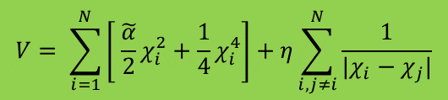
Equilibrium Positions
Minima finding in the following potential:
$$V= \sum_{i=1}^{N}{\left[ \tilde{\frac{α}{2}}χ_{i}^{2}+\frac{1}{4}χ_{i}^{4}\right]+η\sum_{i,j≠i}^{N}{\frac{1}{|χ_{i}−χ_{j}|}}}$$

Slide 4
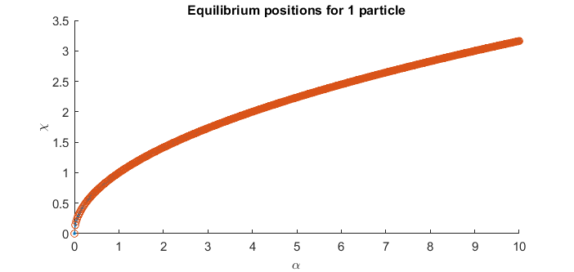
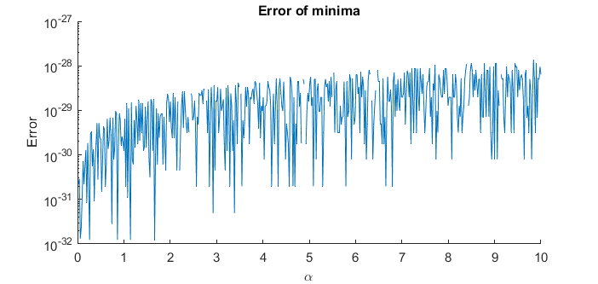
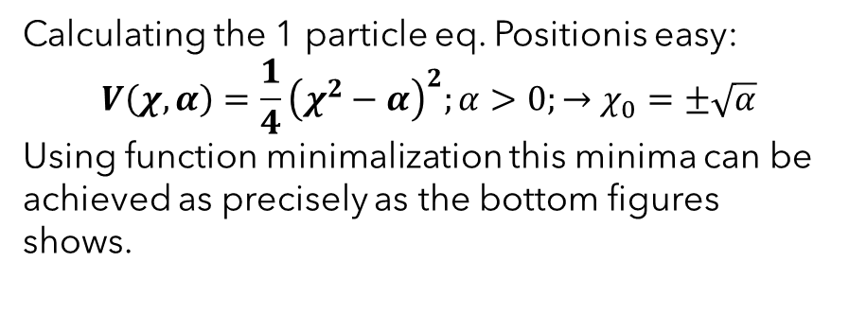
1 - Particle
Calculating the 1 particle eq. Positionis easy:
$$V\left(χ, α\right)=\frac{1}{4}{\left(χ^{2}−α\right)}^{2};α>0;→χ_{0}=±\sqrt{α}$$
Using function minimalization this minima can be achieved as precisely as the bottom figures shows.

Slide 5
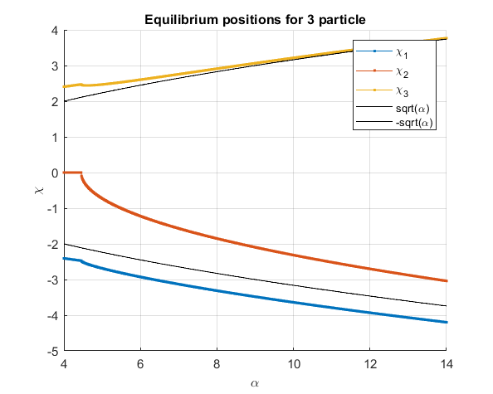
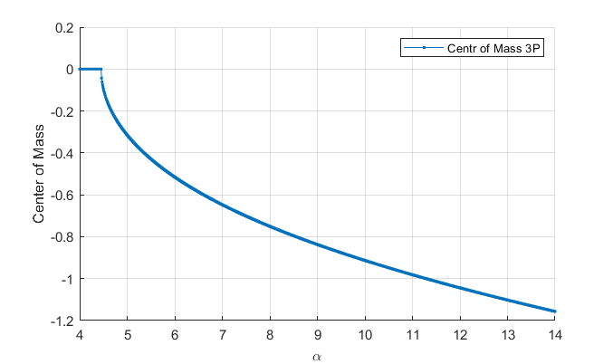
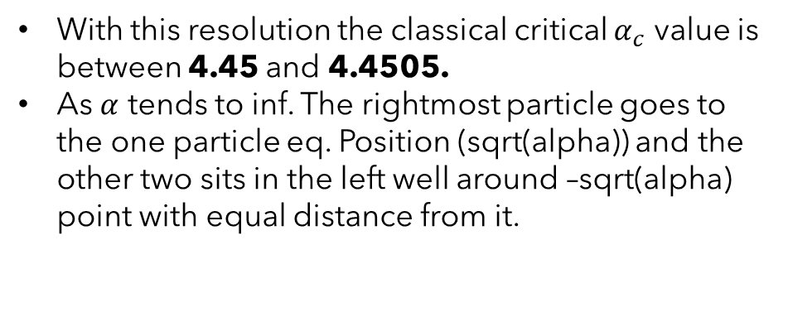
3 - Particles
With this resolution the classical critical $α_{c}$ value is between 4.45 and 4.4505.
As $α$ tends to inf. The rightmost particle goes to the one particle eq. Position (sqrt(alpha)) and the other two sits in the left well around –sqrt(alpha) point with equal distance from it.

Slide 6
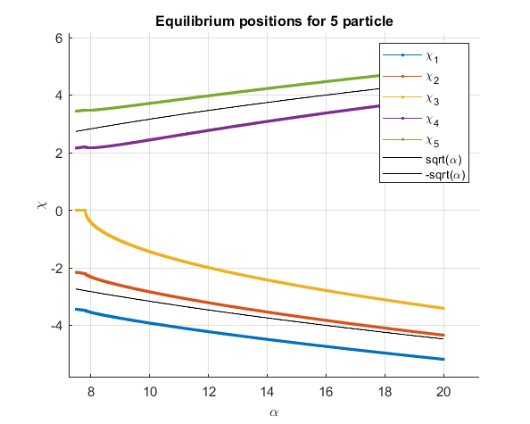
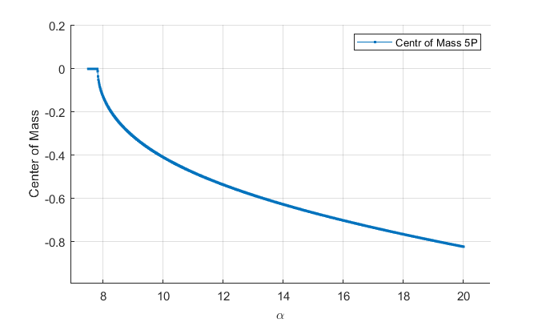
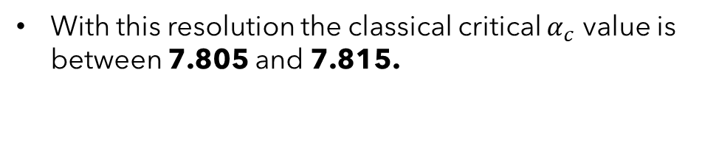
5 - Particles
With this resolution the classical critical $α_{c}$ value is between 7.805 and 7.815.

Slide 7
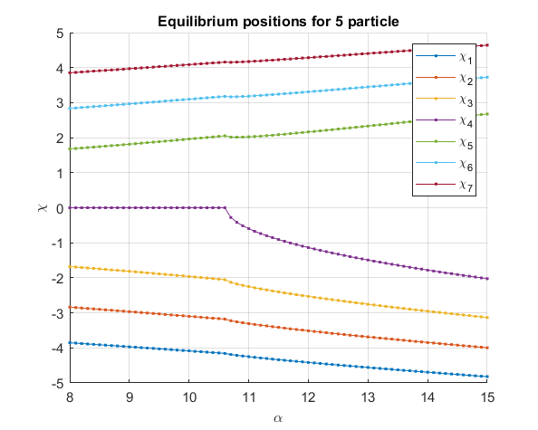
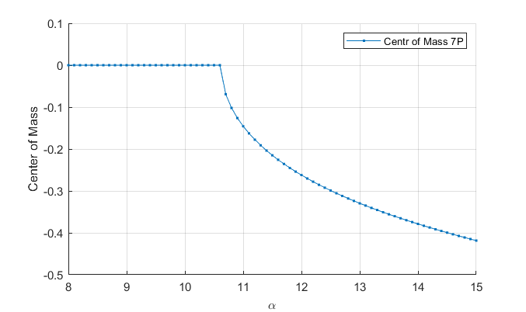
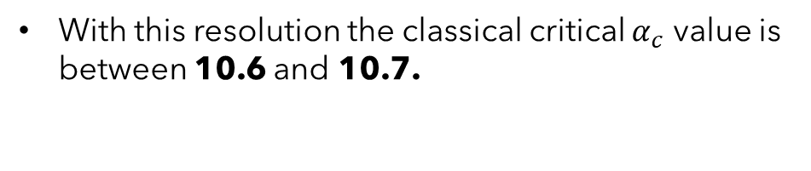
7 – Particles: Unfortunately Matlab’s minimalization algorithm won’t allow 7 independent variables -> MC calculation
With this resolution the classical critical $α_{c}$ value is between 10.6 and 10.7.

Slide 8
7 – Particles
It turns out that the Nelder-Mead minimalization methods works for any particles but the equilibrium position vector norm gives a bigger error compared to 1 or 3 particles. So the Eq.pos. Error is comparable with the MC noise but significantly faster than that.

Slide 9
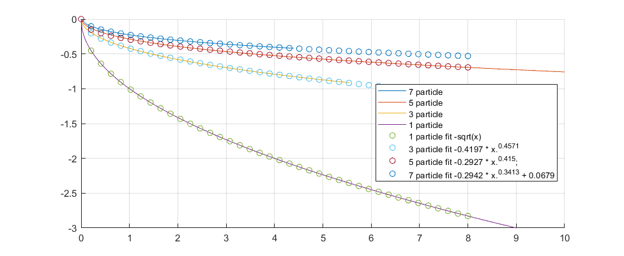
Center of Mass fitted:
All curves are shifted in $α$ with their classical critical value
Center of Mass
alpha

Slide 10
Frequency & Modes
H.o. in the equilibrium positions

Slide 11
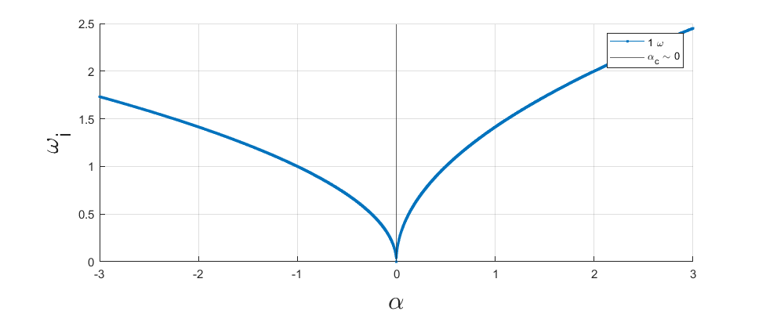
1 - particle
-
Here theres only one mode, so the tunneling direction is obviously in the +\chi direction.

Slide 12
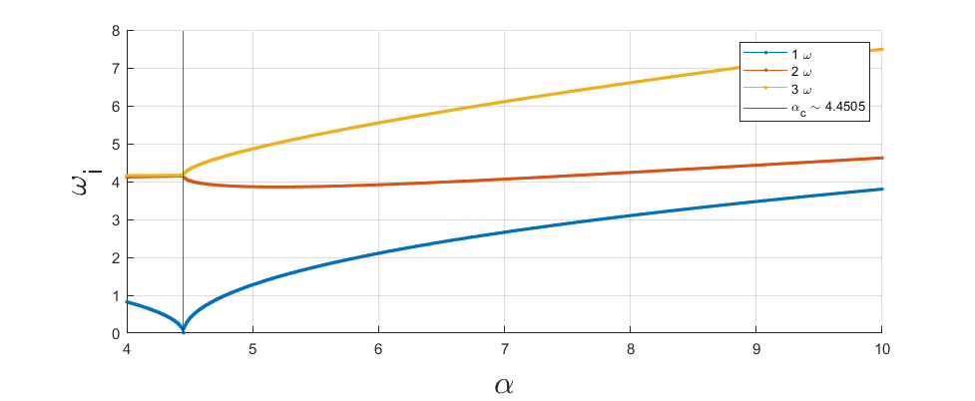
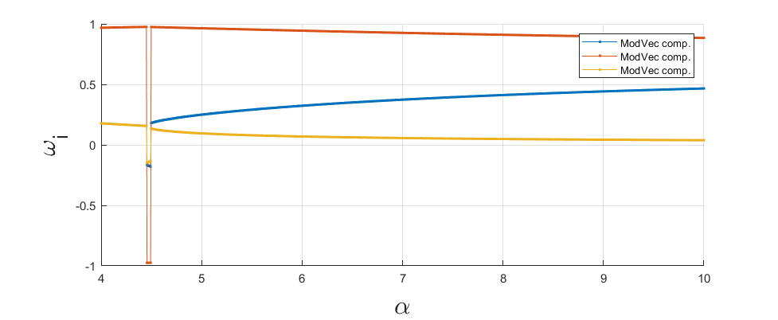
3 - particle
These are the components of Mode vetcorr belonging to the lowest frequency eigvalue.
This also represents the trajectories first derivatives ratio.
-

Slide 13
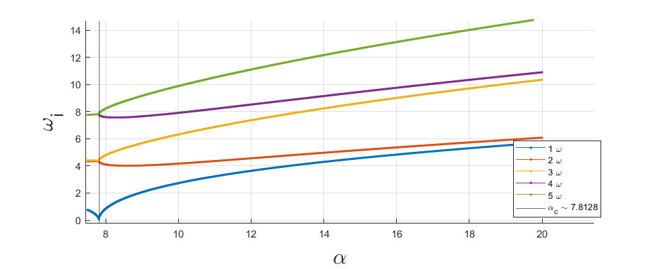
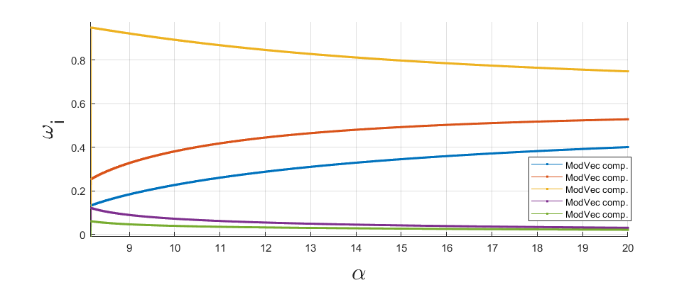
5 - particle
-

Slide 14
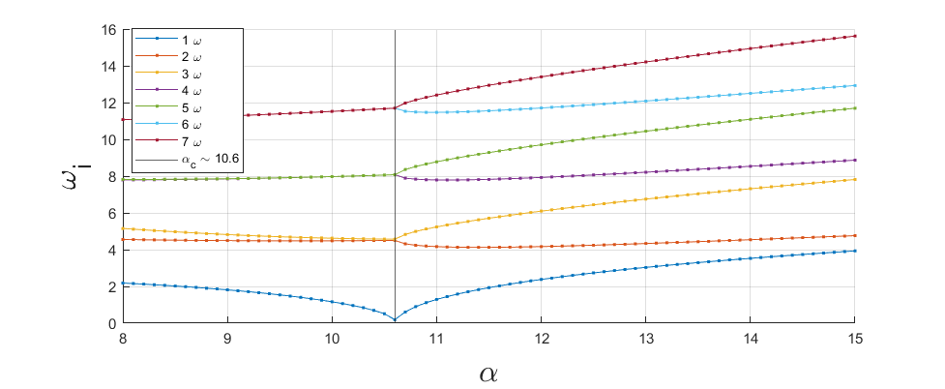
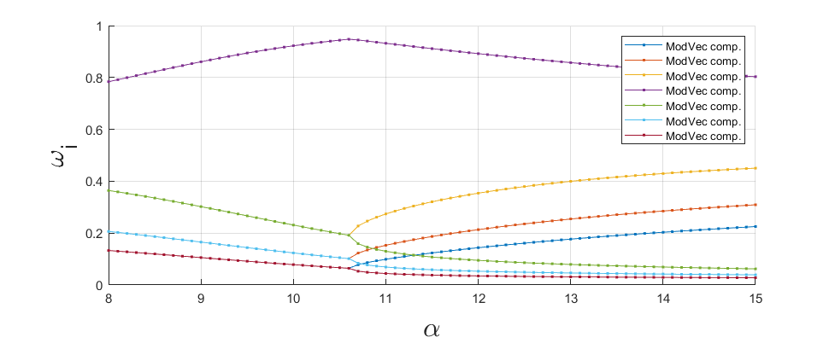
7 - particle
-

Slide 15
Exact Diagonalization
Solving the Schrödinger equation numerically
I made a gif ☺

Slide 16
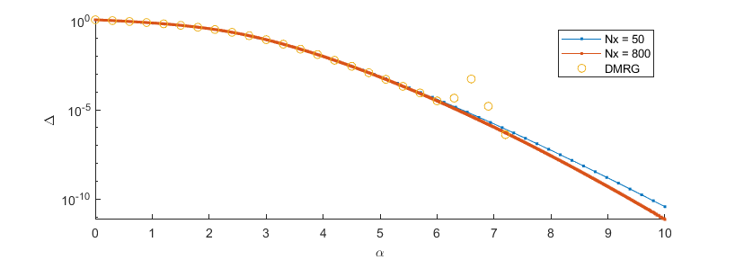
1 - Particle
Nx – Number of spatial points
for 1P 50 is already quite accurate!
DMRG – Pascu’s 1 particle DMRG
We have some anomaly around alpha = 6-7

Slide 17
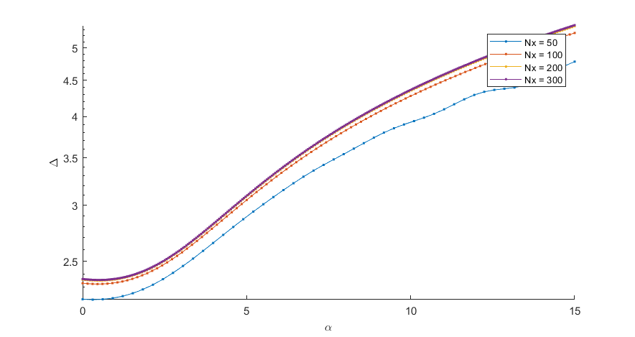
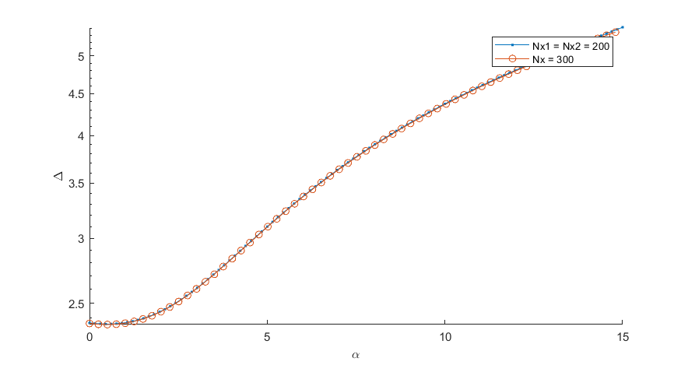
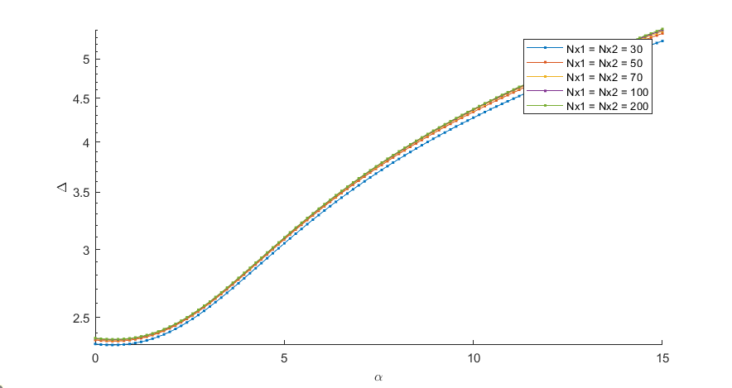
2 – Particle - Full
Comparison between Full Nx = 300 and Restricted Nxi = 200
2 – Particle - Restricted

Slide 18
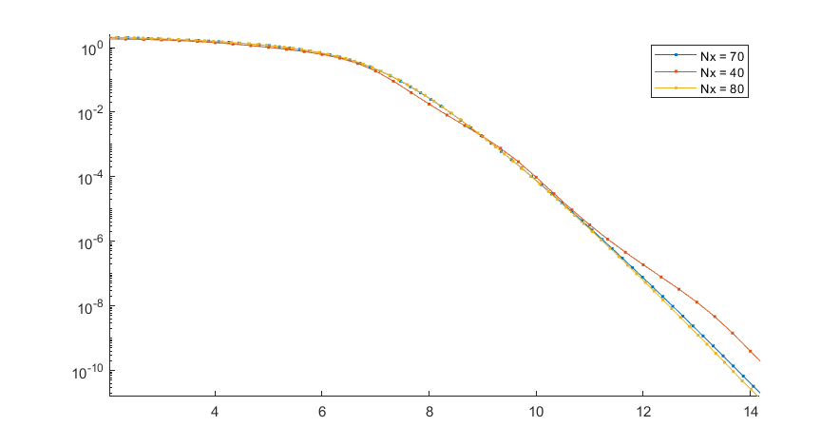
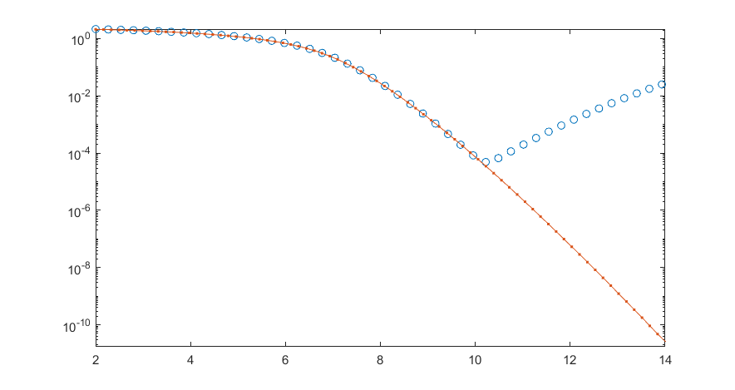
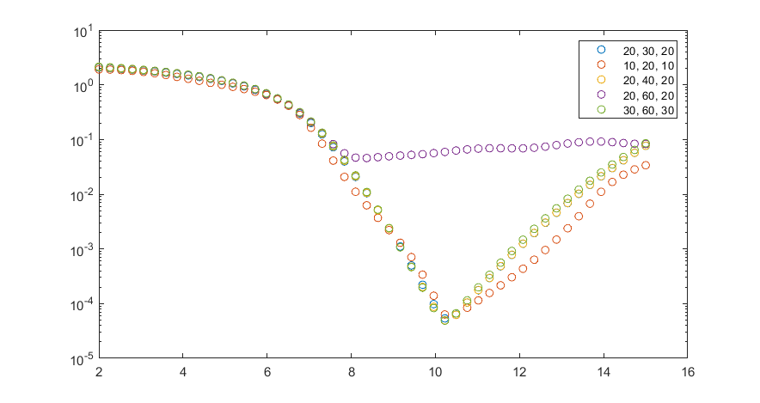
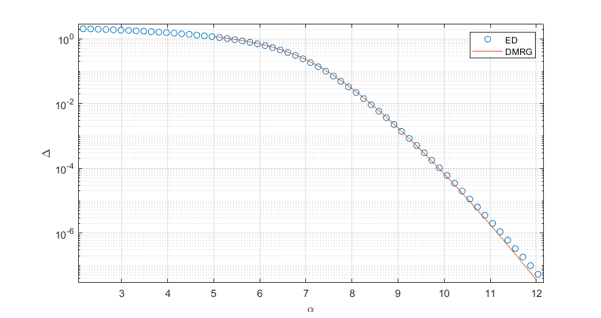
3 – Particle - Full
Comparison between Full Nx = 80 and Restricted Nxi = 30,60,30
The restricted version fails after alpha = 10, but that is already below 10^-4 splitting
3 – Particle - Restricted
ED & DMRG comparison

Slide 19
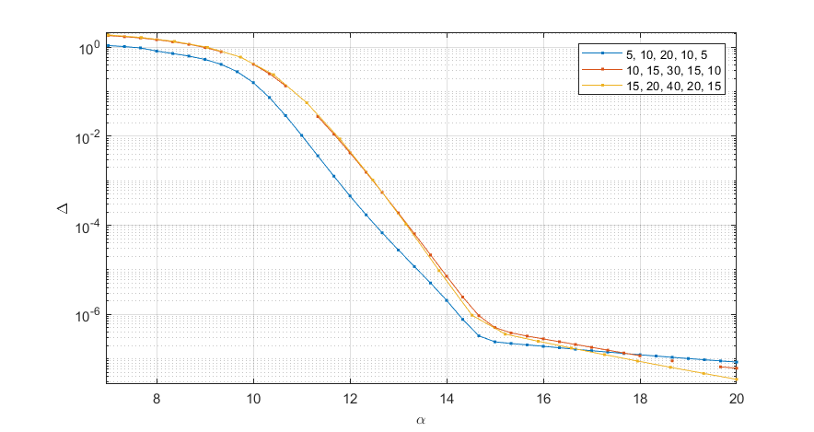
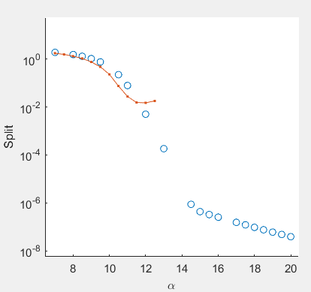
5 – Particle
Latest DMRG compared to 5 particle ED
…

Slide 20
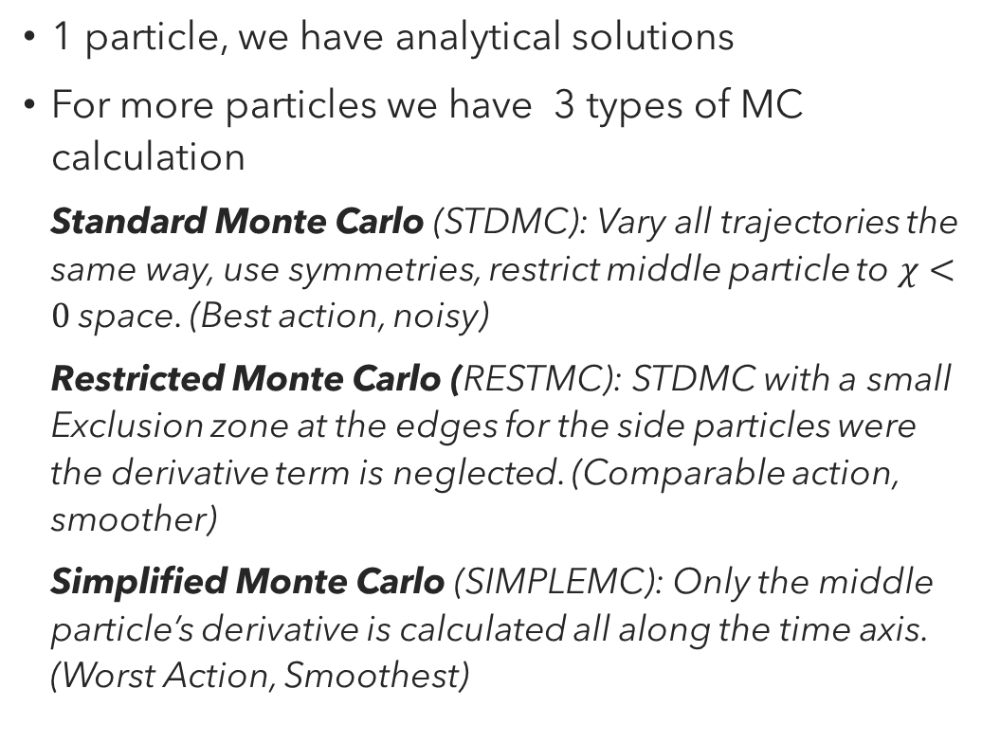
Trajectory Calculation
1 particle, we have analytical solutions
For more particles we have 3 types of MC calculation
Standard Monte Carlo (STDMC): Vary all trajectories the same way, use symmetries, restrict middle particle to $χ<0$space. (Best action, noisy)
Restricted Monte Carlo (RESTMC): STDMC with a small Exclusion zone at the edges for the side particles were the derivative term is neglected. (Comparable action, smoother)
Simplified Monte Carlo (SIMPLEMC): Only the middle particle’s derivative is calculated all along the time axis. (Worst Action, Smoothest)

Slide 21
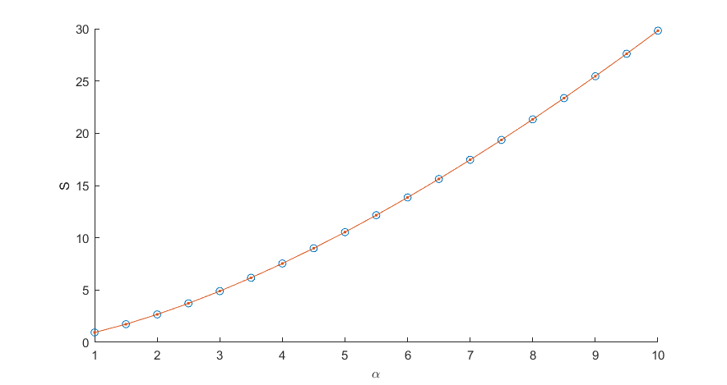
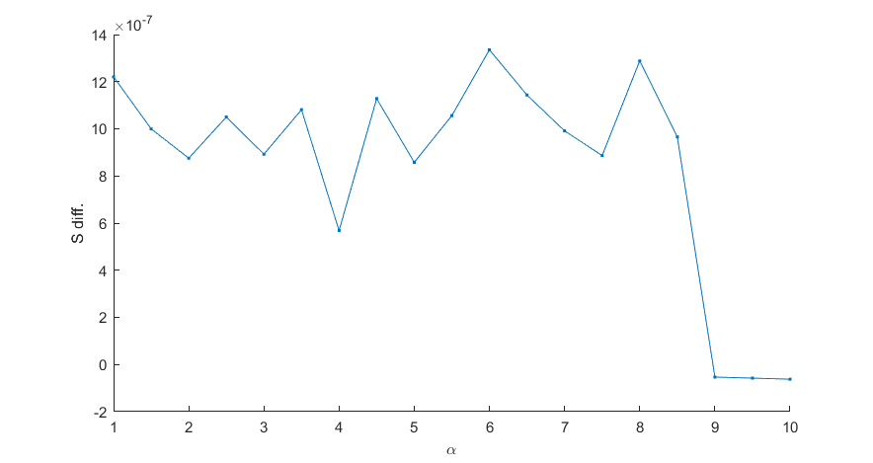
1 - Particle
We can calculate this analytically, good for setting up the MC
Difference of the action calculated from MC and the Analytical curves’ action. (This get exponencialized, so practically identical)

Slide 22
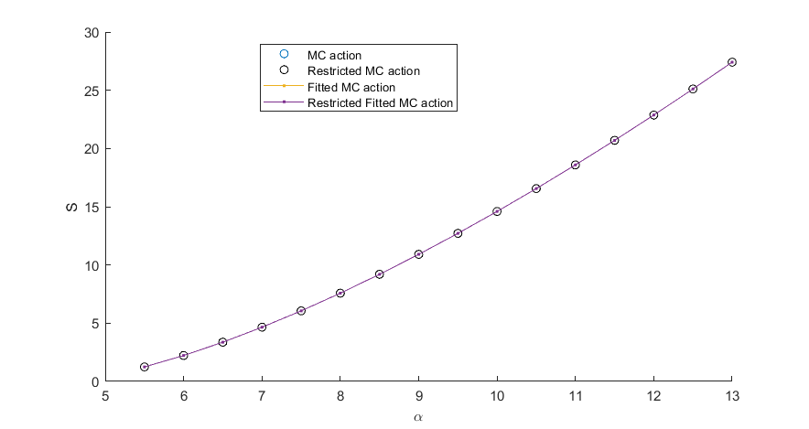
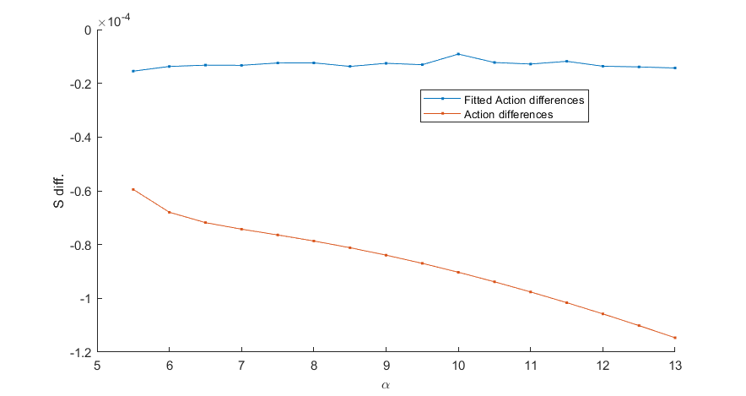
3 - Particle
Action differences: Difference between the restricted and regular MC calculation actions
FittedAction differences: tanh(…) fit for the calculated MC curve
Doing a standard MC/SA with twice as much iterations as the restricted or simplified variants grants us a bit better solution it seems.
Neglecting the derivative terms in the action integral gives a very good match with the standard MC when the alpha is small, but as expected when alpha gets bigger, the derivative term gets more and more relevant so the trajectories start to idffer from stdMC
Runtimes:
w/ all the restrictions the fastest (/iteration) is the standard MC -> 20k iterations under a second
Restricted is similar to the STDMC but still slower 20K iteration ~ 1.1 – 1.2 seconds
SIMPLEMC: slowest, 20K iterations above 1.5 seconds

Slide 23
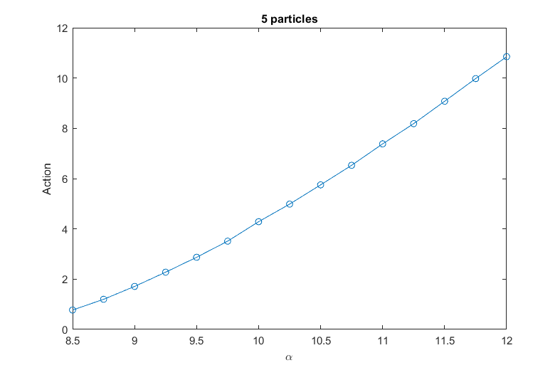
5 - Particle

Slide 24
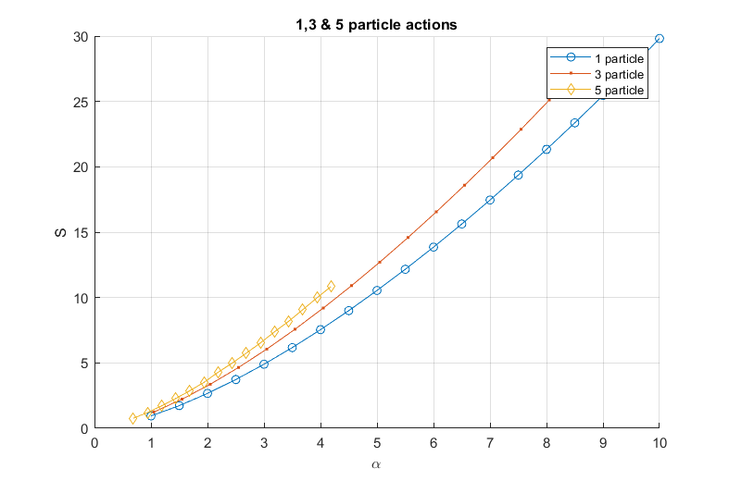
1-3-5 – Particle scaled together
Scaled together with the classical critical alpha values (see previous slides)

Slide 25
Splitting Calculation
1,3 and 5 particle splitting comparison
ED
DMRG
Numerics

Slide 26
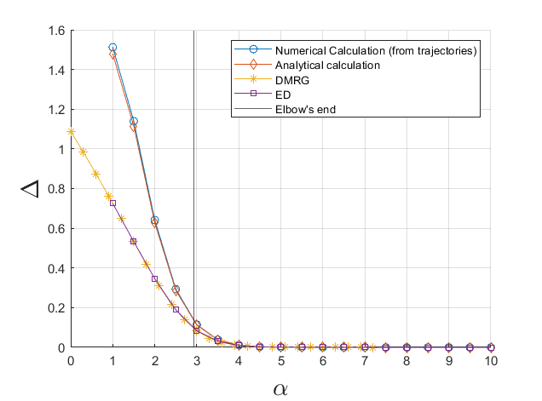
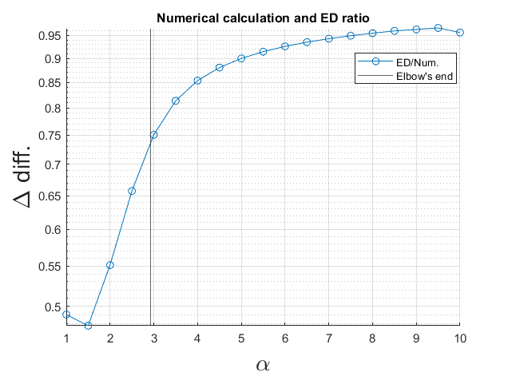
Fitting a linear eq. To the first part, the „elbow” is around alpha = 2.934
The Instanton too has a linear section, which gives almost the same „elbow” point
From fit alpha = 2.83

Slide 27
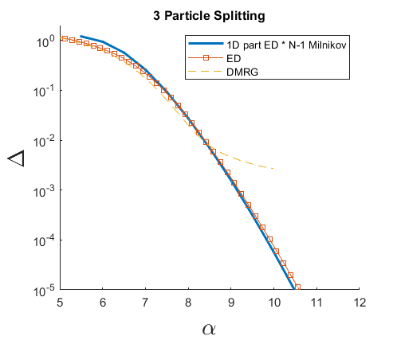
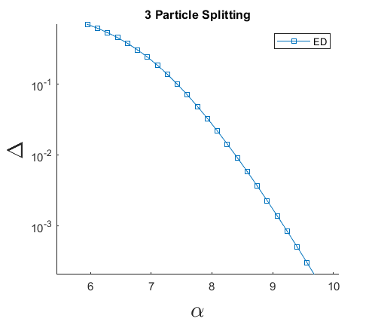
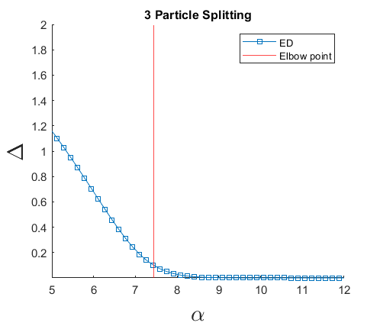
ED calculated from V(S) effective potential (extended by a 2nd order polynomial) multiplied by Milnikovs N-1 dimensional part. Looks very good!!!
Yellow dash – Pascu DMRG
Elbow point at alpha = 7.44
The numerical splittings start above the ED and finished below that. The alpha where they cross is roughly at the Elbow point (alpha = 7.7 – 7.8)
Used all 3 trajectory calculation method to check this, seems like the STDMC is best when alpha is small, then after 7-8 the RESTMC becomes more accurate. The SIMPLEMC is close but it is the worst.

Slide 28
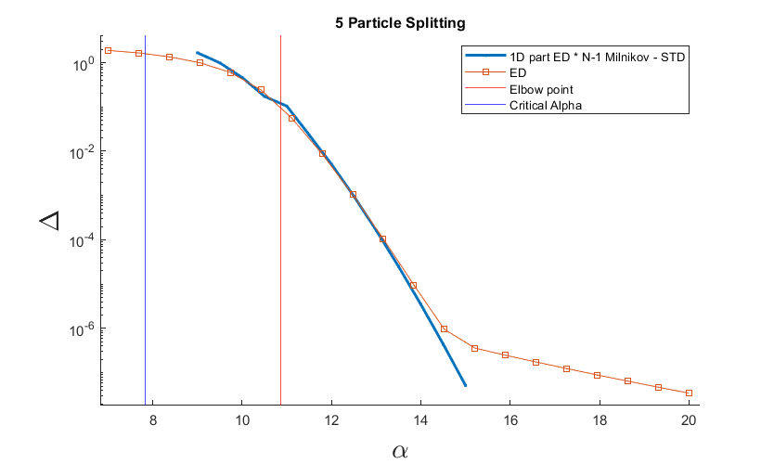
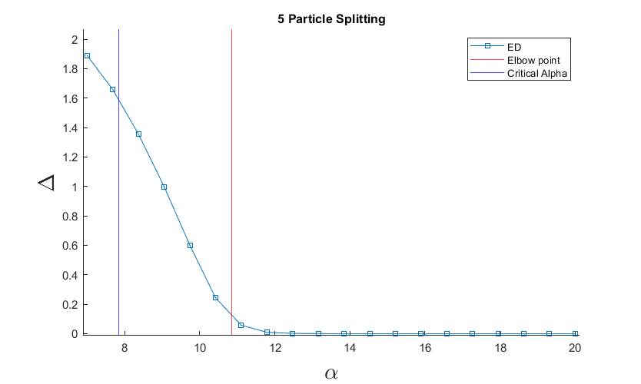
You can see a bit of a twitch in the splitting. I think (and the rotation matrix + differential equation solution backs this) That it is caused by the number of points used in the trajectories. Before the twitch there is only 120 points on the curves after it theres 160.
ED calculated from V(S) effective potential (extended by a 2nd order polynomial) multiplied by Milnikovs N-1 dimensional part. Looks very good!!!
Yellow dash – Pascu DMRG
The „Elbow point” (from a linear fitting) is around alpha = 10.86
The ED is my restricted calculation. This obviously fails around alpha = 15, but matched Pascu’s preliminary DMRG data when alpha was small.
This is now fixed !

Slide 29
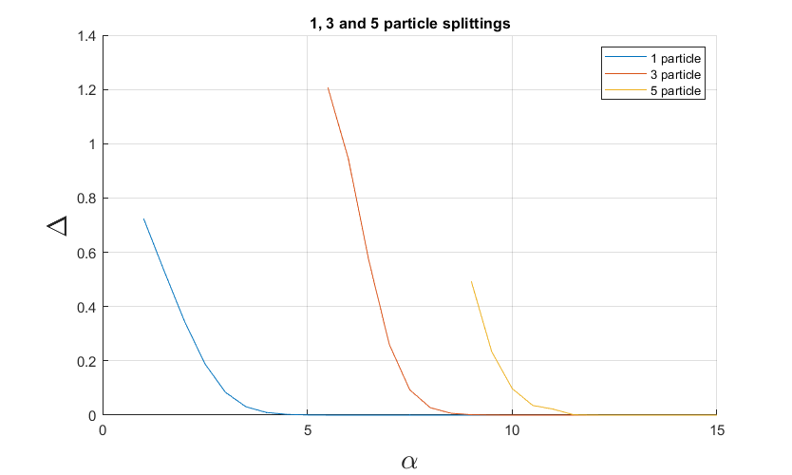
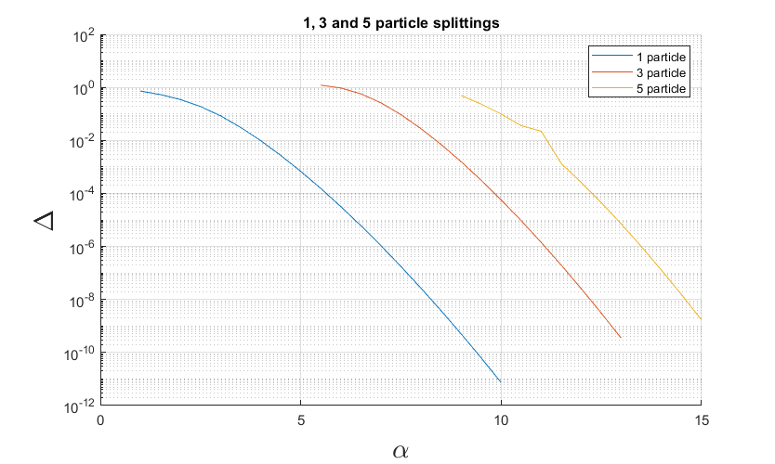

Slide 30
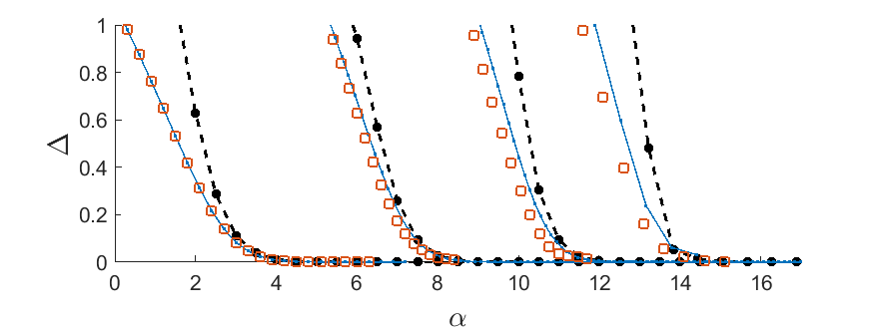
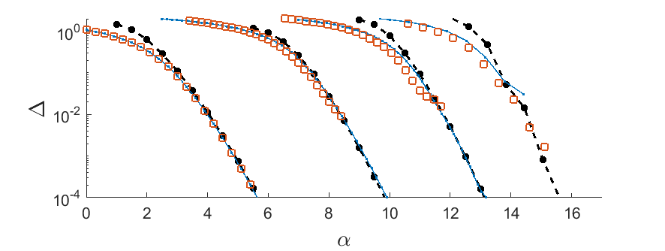
Tunneling splitting comparison

